Slide 1
Financial Best
Practices Questions

Slide 2
The important and difficult job is never to find the right answer, it is to find the right question.
Peter Drucker, The Practice of Management (1954)

Slide 3
Question #1:
Is my financial life organized and protected?

Slide 4
Question #1:
Is my financial life organized and protected?

Slide 5
Question #1:
Is my financial life organized and protected?

Slide 6
Question #2:
What are the long-term costs to my financial habits?

Slide 7
Question #3:
How much is enough?

Slide 8
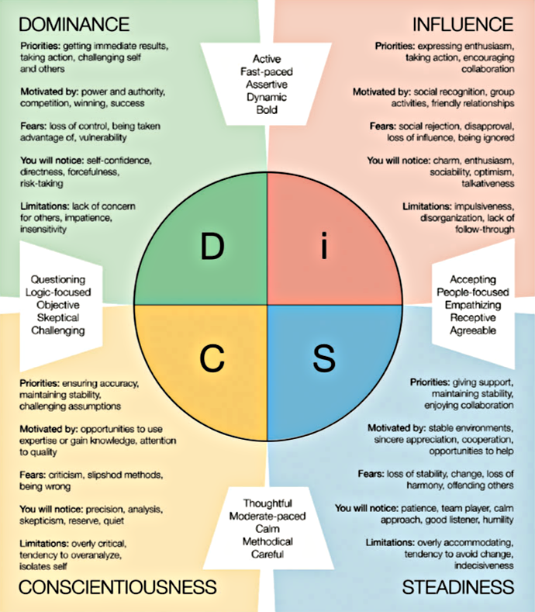
Question #4:
What motivates US to reach OUR financial goals?

Slide 9
Financial Best
Practices Questions

